Slide 1

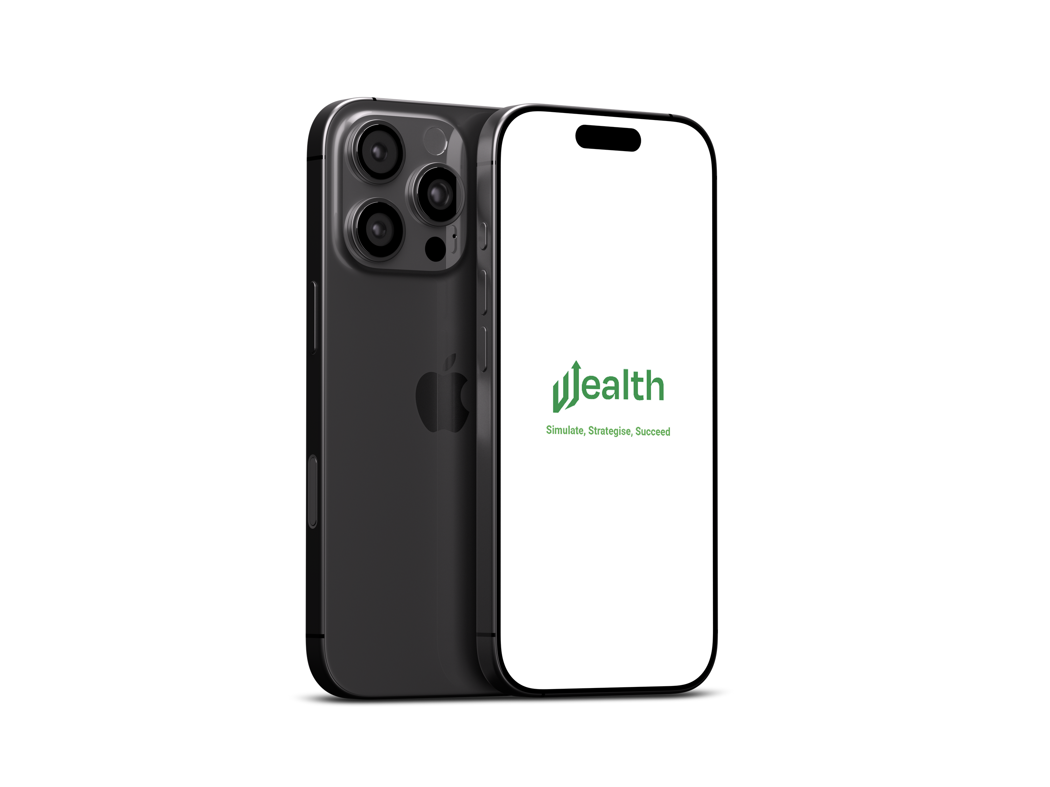


Team W#
Yashraj Sakunde
Aditanshu Sahu
Yashvardhan Singh
Jayesh Raheja
Rishit Kumar
1

Slide 2
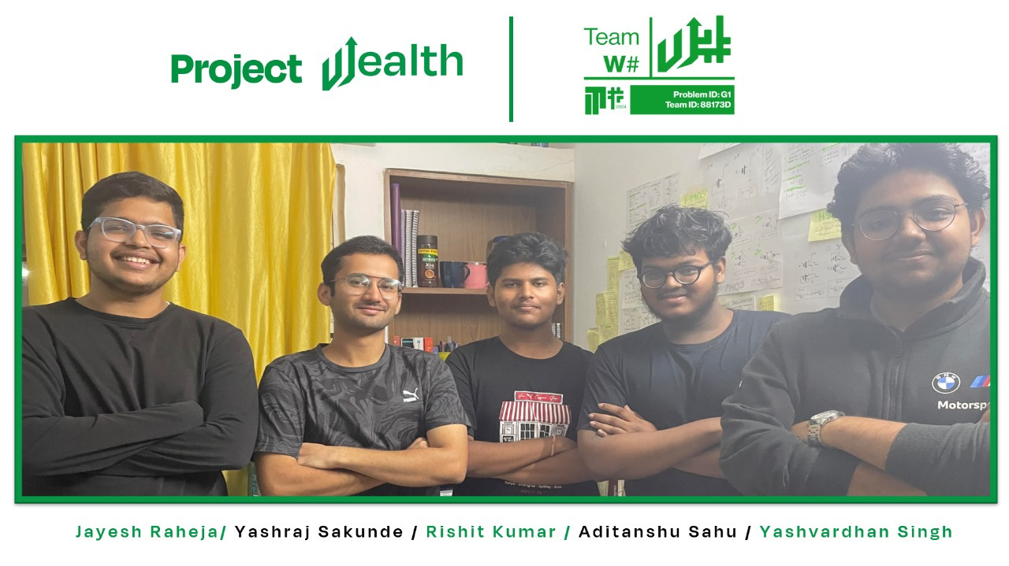
2

Slide 3



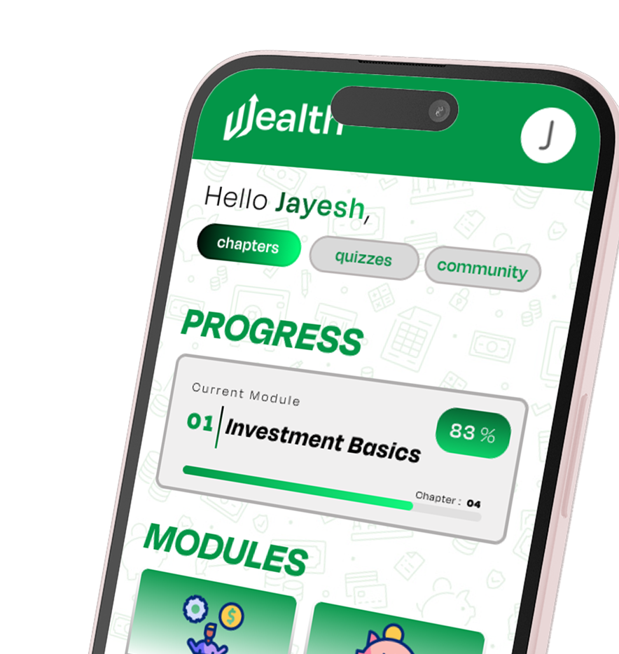
PROJECT
Project Wealth aims to create a mobile app that simplifies mutual fund investing for youth through engaging simulations, educational content, and interactive features like quizzes, virtual portfolios, and challenges, making financial literacy fun and accessible.
3
Notes:
Team Photo, give brief introduction.

Slide 4


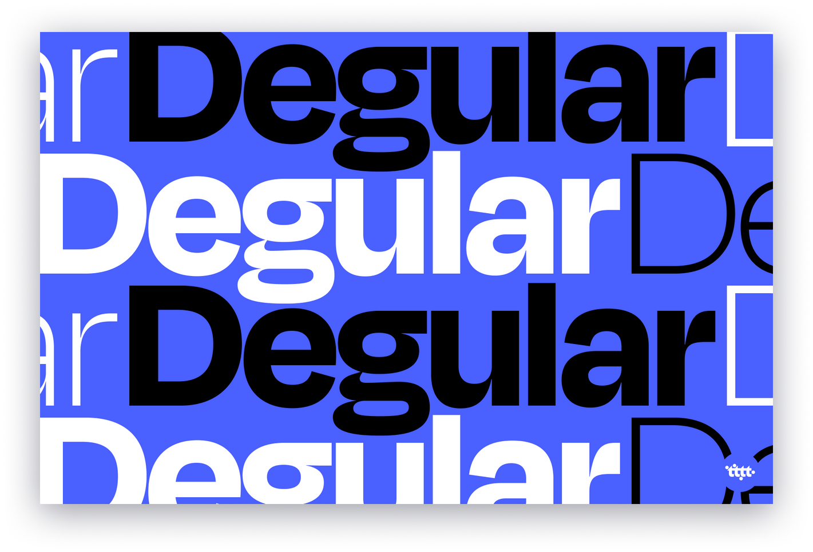
APP BRAND IDENTITY
The Wealth Symbol/Logomark features a W shaped symbol representing a Upward Inclining graph. The primary color we have adapted is green, to give a comforting and welcoming environment through our app, which will nurture the youth and help develop their financial literacy. The primary font family used is the Degular Display font family, primarily chosen for
its professional and minimal aesthetics.
WEALTH WORD LOGOMARK
Color
Pallete
WEALTH SYMBOL LOGOMARK
4
Notes:
Basic Introduction to our project alongside problem statement and our solution to it.

Slide 5


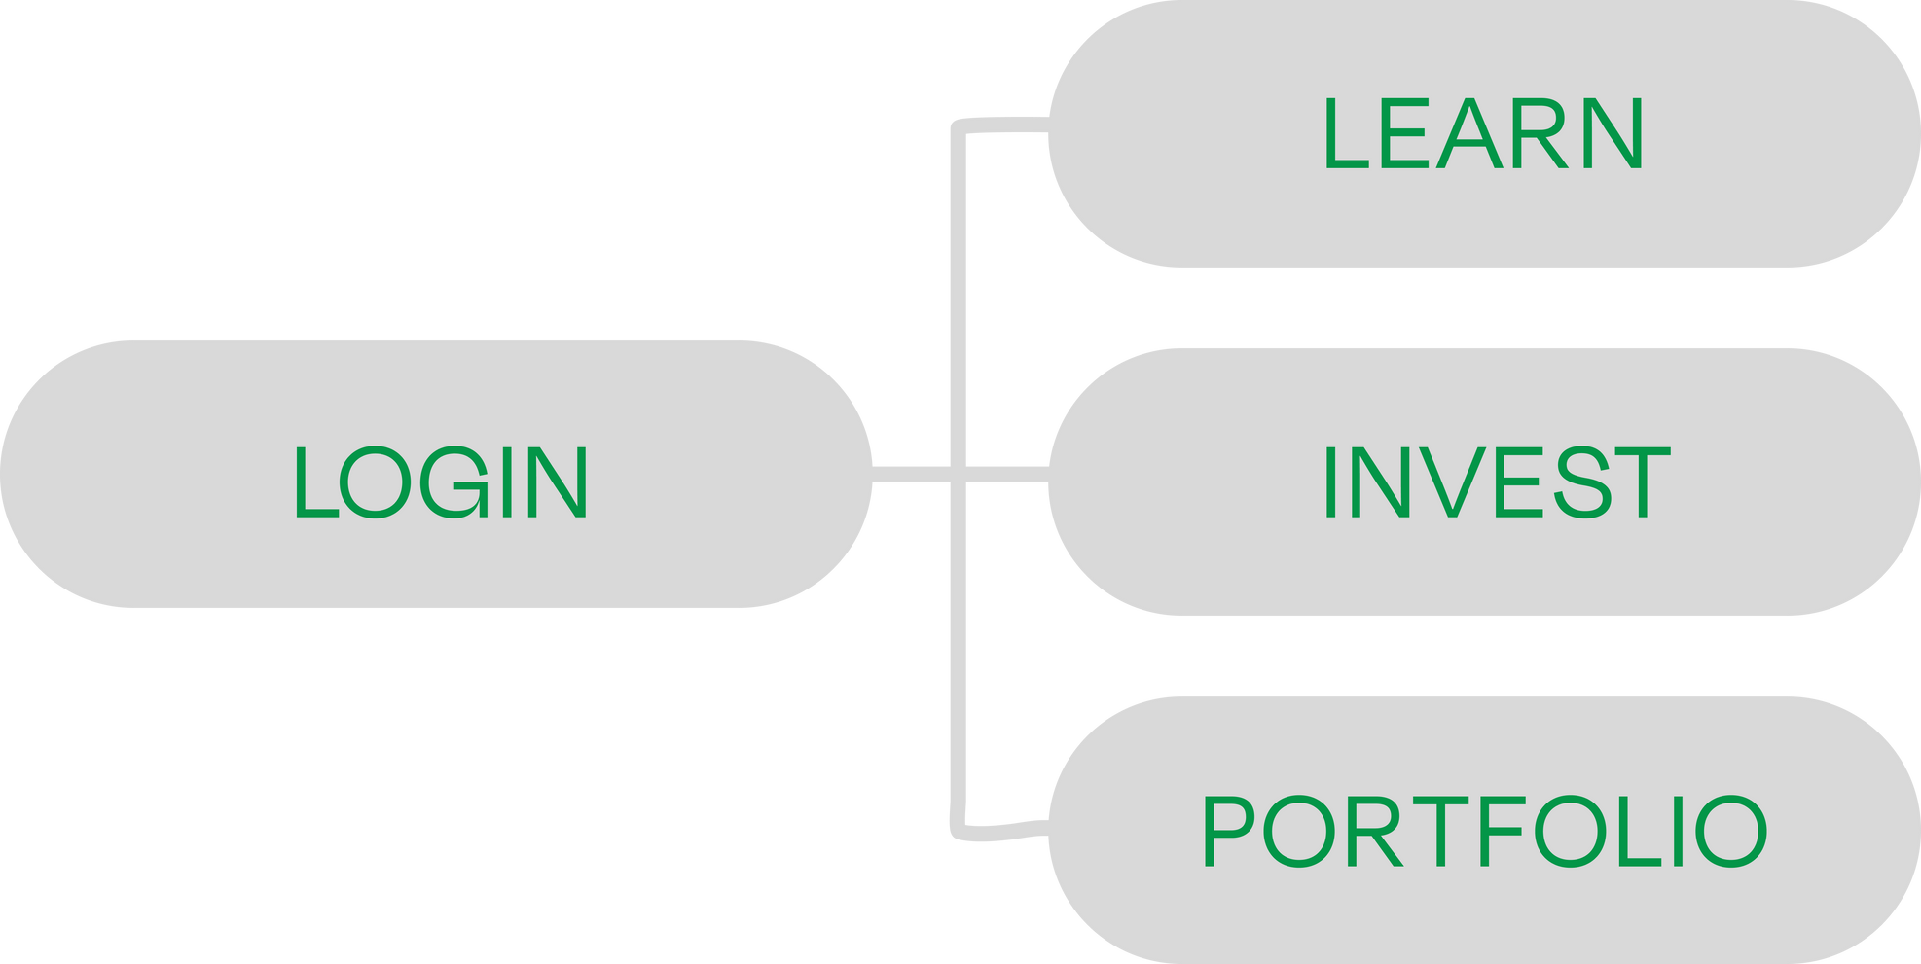
APP WORKFLOW
Initial Interface
5
Notes:
Logomarks and other design choices explained.

Slide 6

6

Slide 7

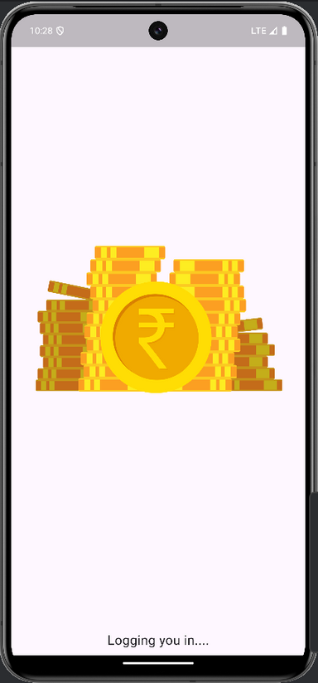
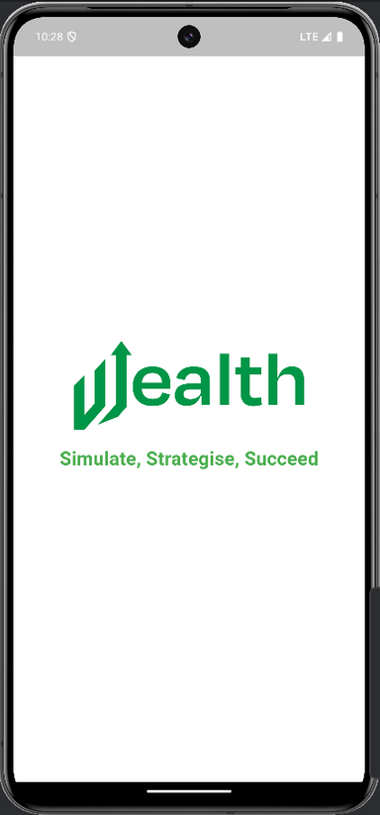
Splash Animation
Our app starts with a splash screen displaying our app logo and quote defining our aim
behind it’s creation.
7
Notes:
initial interface

Slide 8
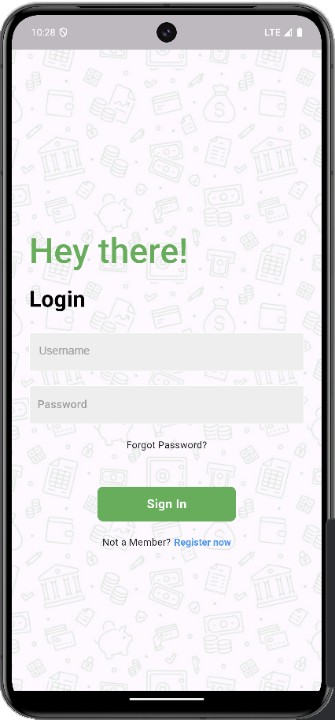
Login Page
User sign in takes place through Username and password.
8
Notes:
Splash animation loading screen at the very beginning.

Slide 9

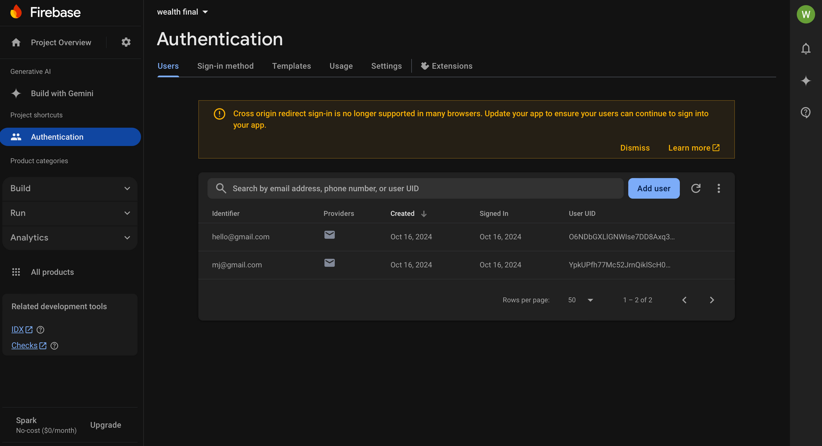
Firebase UserAuth
The details entered are cross-checked from firebase cloud storage.
9
Notes:
login screen interface

Slide 10
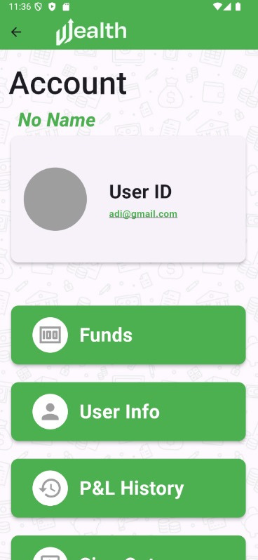
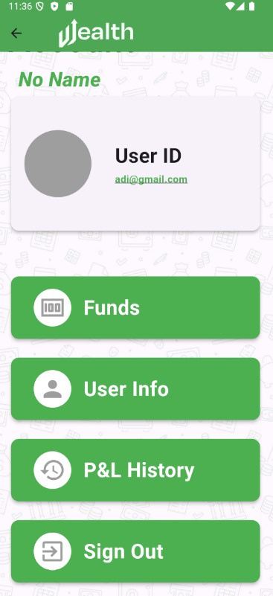
Profile Page
The icon on the header section is the profile button which leads to the profile page of the user displaying the username, userID and options to view funds, userinfo and P&L history of user.
10
Profile Landing Page On Scrolling Down
Notes:
firebase based user authentication - cloud storage

Slide 11
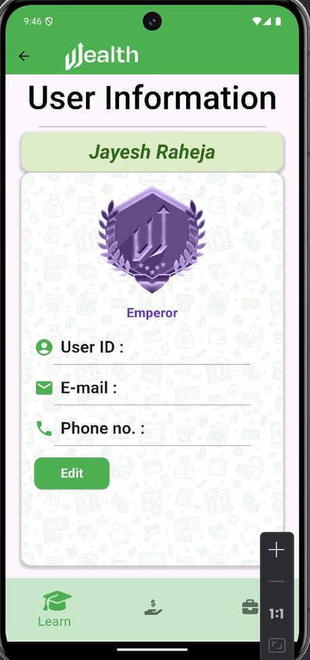
User-Info Page
This page contains extra details of the user which includes phone number, email and user ID where user has the option to edit phone number.
User Info Page
11
Notes:
firebase based user authentication - cloud storage

Slide 12
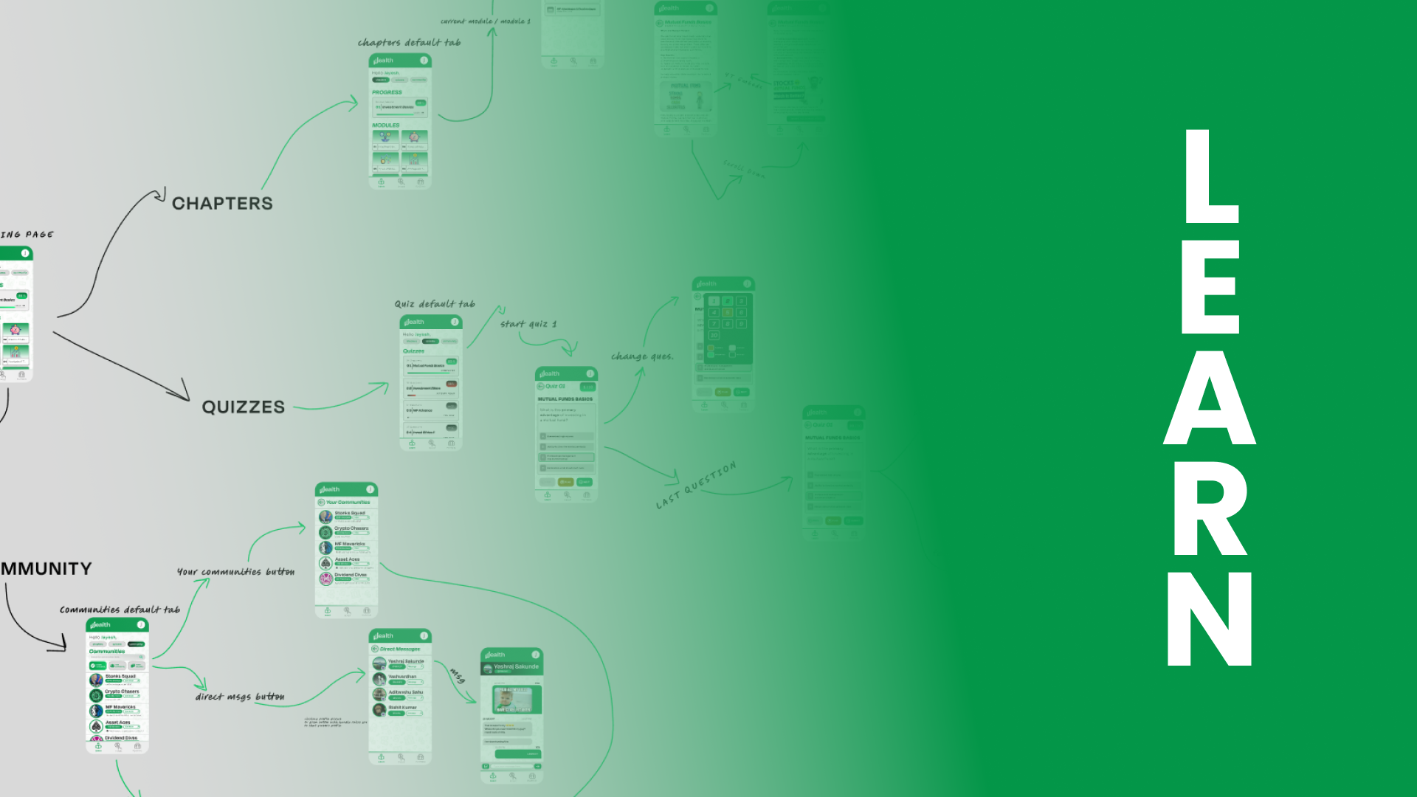
12

Slide 13
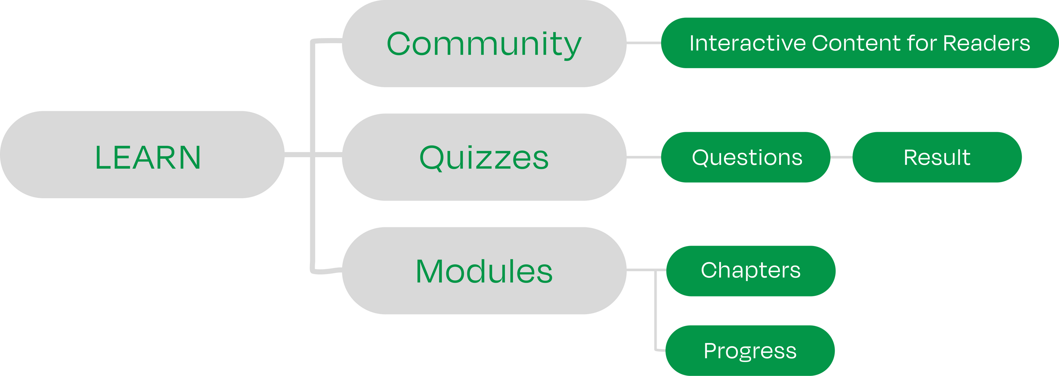
APP WORKFLOW - II
Learn Interface
13
Notes:
Learn Sectional Separator

Slide 14

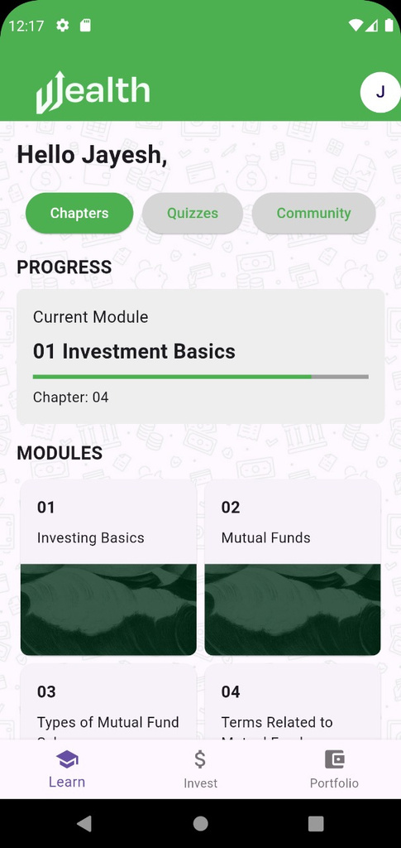
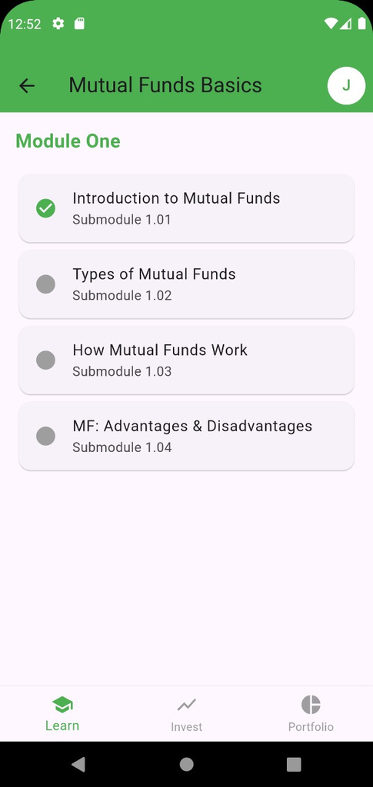
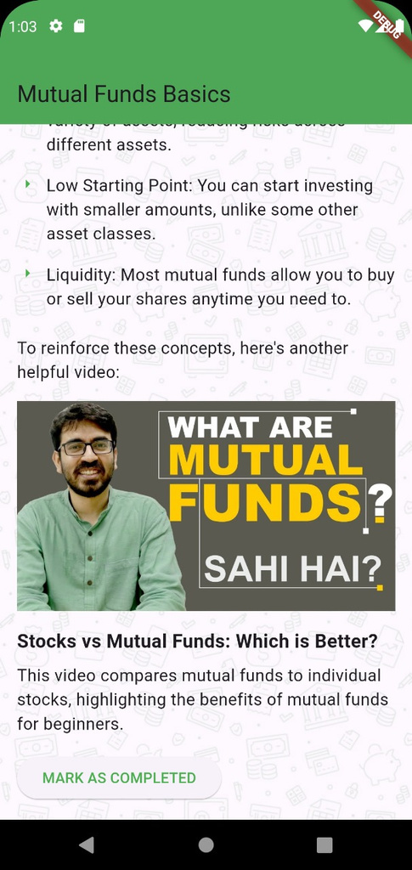
Learn Homepage
Our learn page offers a comprehensive learning experience with chapters, quizzes, and a community.
Chapters page features 10 comprehensive modules covering all aspects of mutual fund investing.
Learn Landing Page
Chapters in Module
Chapter Content
14

Slide 15
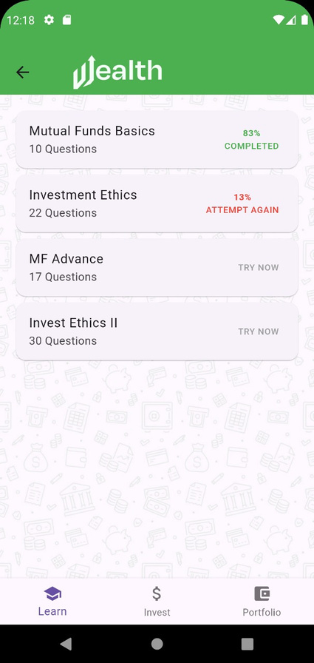
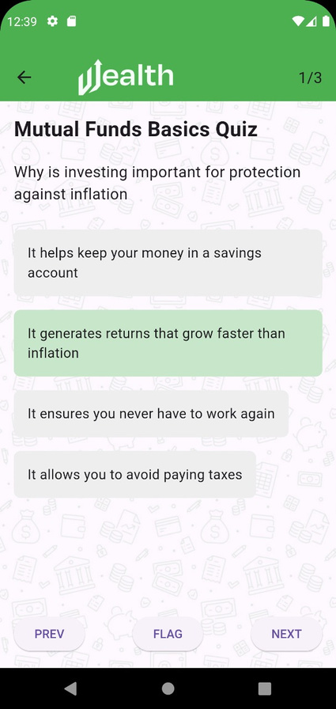
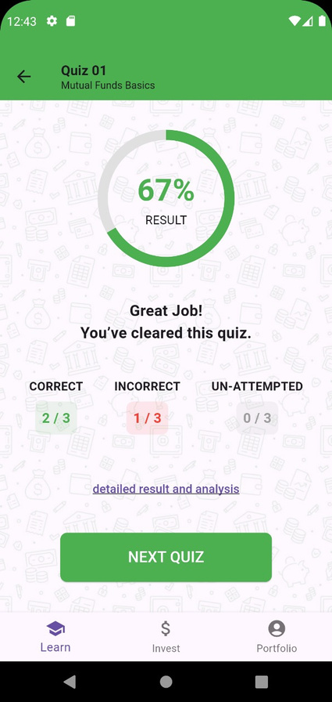
Quizzes
Our quizzes page offers interactive assessments for
each module, allowing users to test their understanding of mutual fund concepts.
Quizzes Landing Page Questions Menu Results Interface
15

Slide 16
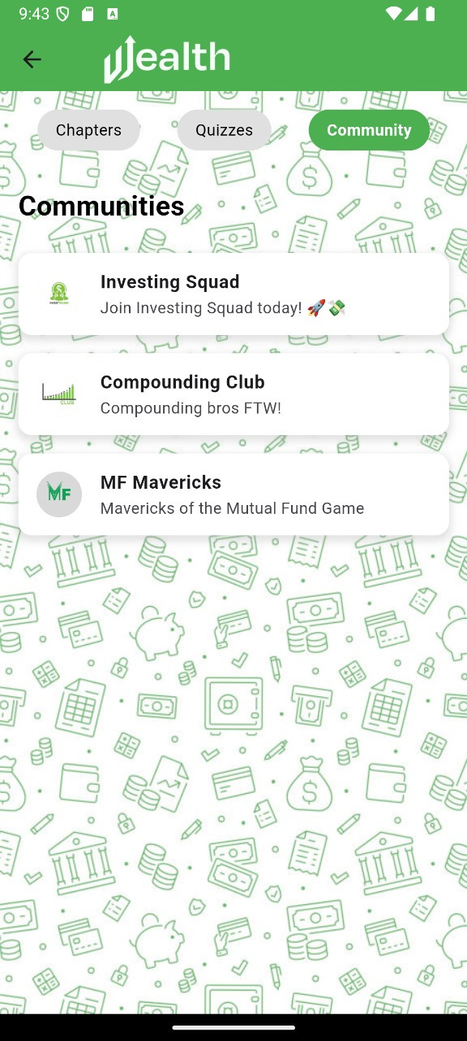
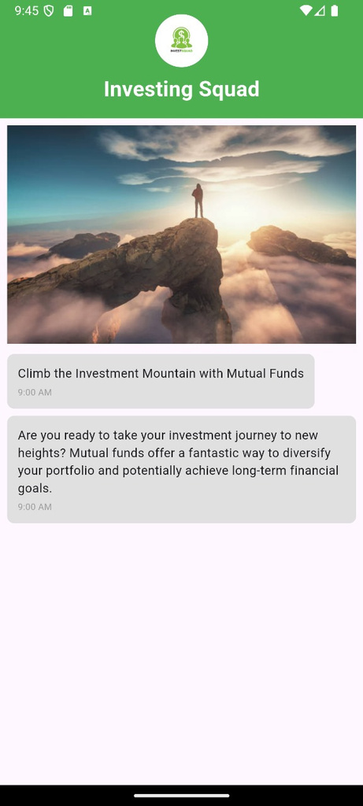
Community
Communities Landing Page Content inside communities
Community tab showcases different investment-focused groups where users can learn and grow together in their financial journey.
This is view-only content for the users.
16

Slide 17
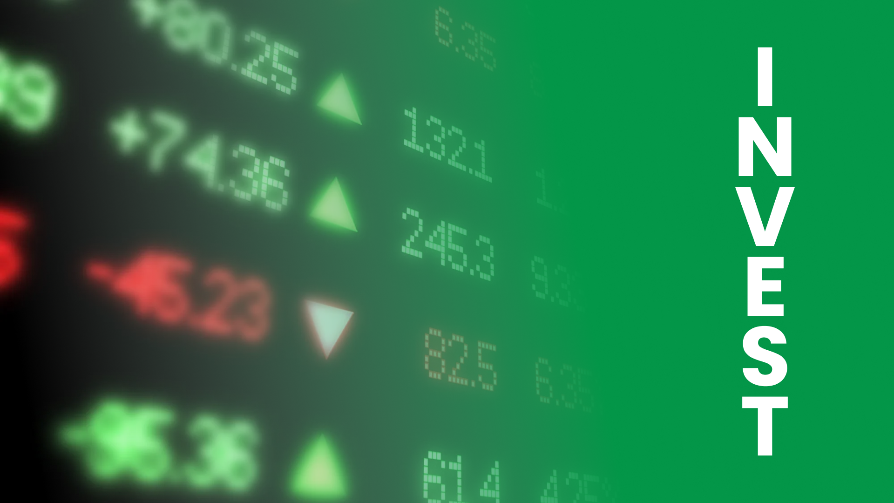
17

Slide 18
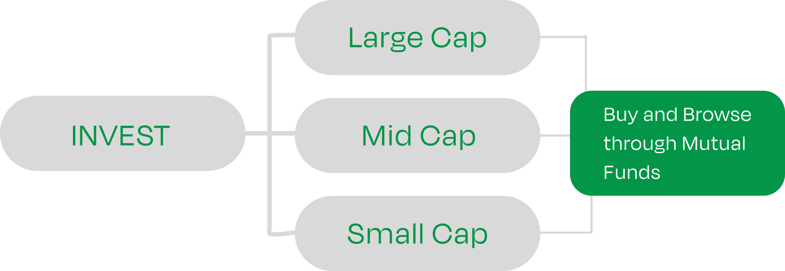
APP WORKFLOW - III
Invest Interface
18

Slide 19

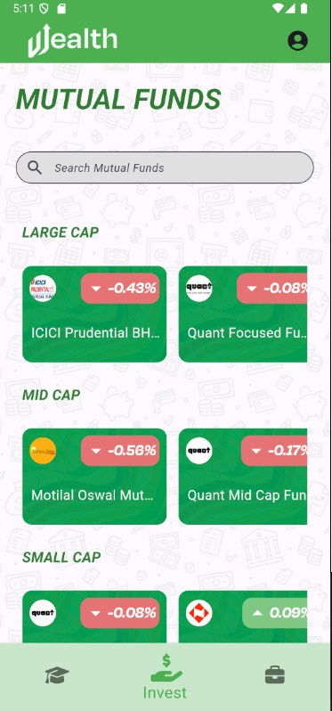
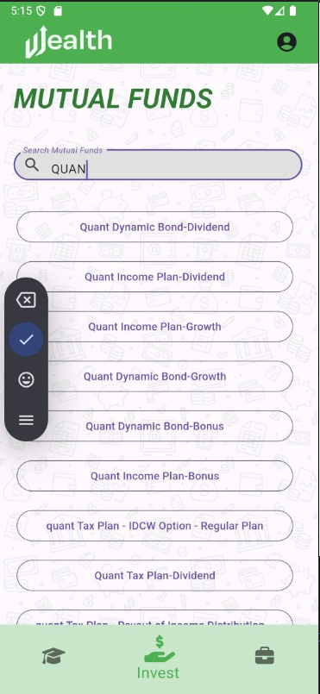
Invest Homepage
Invest Landing Page
Invest Search bar
This page has the mutual funds segregated in to large cap, small cap, and mid cap. It also features a search bar to look up a specific Mutual Fund.
The data through mutual funds is fetched through MF API, which provides details about
NAV, Scheme category, Last Updated price, and all the historical prices.
1
19

Slide 20
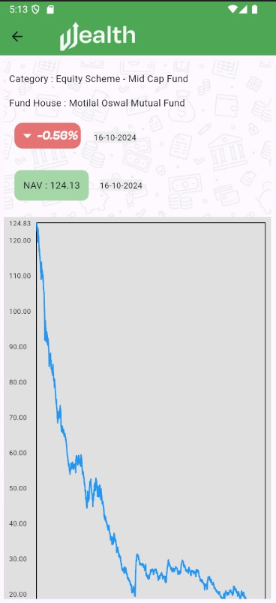
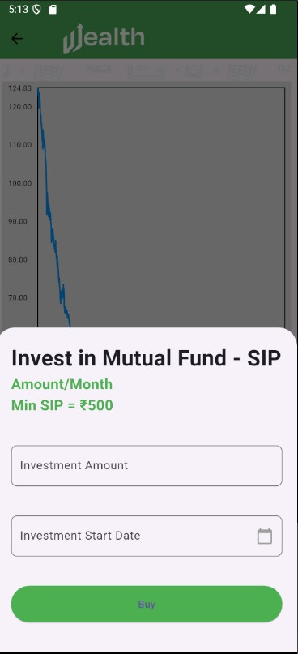
SIP & Graphs
MF Graph View
Start SIP & One-time
We have an option to enter the amount to be invested and start the sip on any specific date which we can choose through the calendar.
We have details about percentage up and down alongside it’s graphical trends over time.
1
20

Slide 21
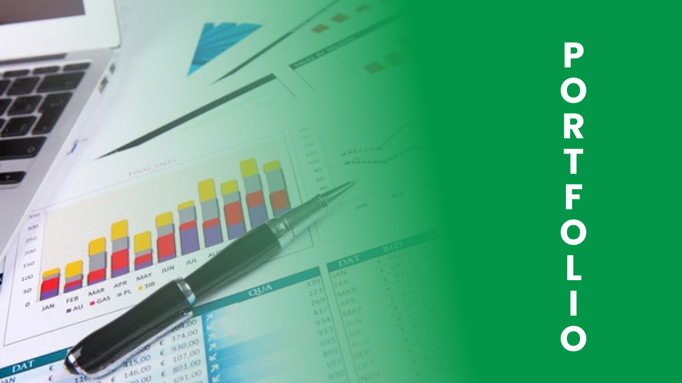
21

Slide 22
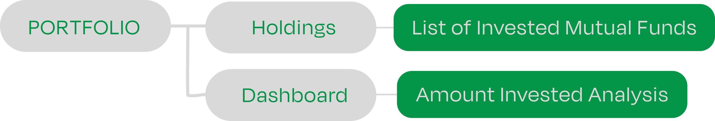
APP WORKFLOW - IV
Portfolio Interface
22

Slide 23
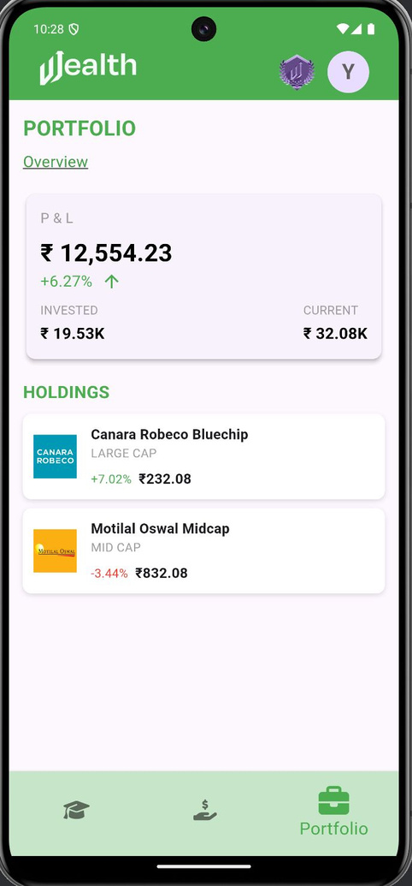
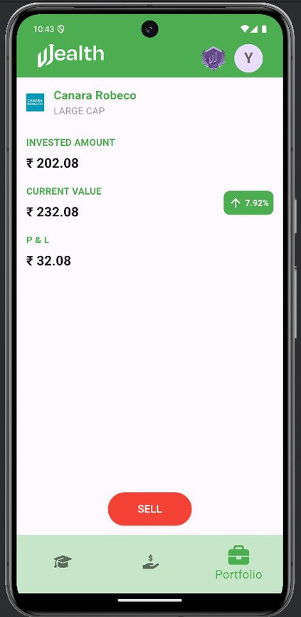
Portfolio Landing Page
Portfolio Page (Dashboard)
Holding Description
Portfolio page consists of the list of active mutual funds the user has currently bought.
It also displays the total amount of money invested and its current value based on the mutual fund trends.
1
23

Slide 24

24

Slide 25





BADGE REWARD SYSTEM
Badges
Levels
1
2
3
4
5
Rank Name
ROOKIE NOVICE KNIGHT LORD EMPEROR
Eligibility
Obtained after Module 2: Introduction to MF
Obtained after Module 4: Terms related to MF
Obtained after Module 6: Advantages & Risk
Obtained after Module 8: Return Ratios
Obtained after Module 10: How to invest in MF
Benefits
20K Coins added
New Bronze Cosmetic Badge
40K Coins added
New Silver Cosmetic Badge
60K Coins added
New Gold Cosmetic Badge
80K Coins added
New Emerald Cosmetic Badge
100K Coins added
New Diamond Cosmetic Badge
25
GAMIFIED REWARD SYSTEM OF LEARNING AND INVESTING PROCESS.

Slide 26

26

